Slide 1
METHODS OF PERFORMANCE APPRAISAL
Cdr Vijay Pratap Singh,
Adjunct Professor, E&TC

Slide 2
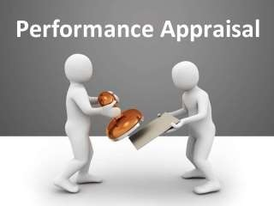
Performance Appraisal
Performance appraisal can be described as a systematic evaluation of performances of several employees so that they can understand all abilities of a person and their development and growth. Performance appraisal is also done in a very systematic manner which includes measuring the pay of employees and comparing it with all plans and targets.

Slide 3
Methods of Performance Appraisal
TRADITIONAL METHODS
MODERN METHODS
.

Slide 4
Traditional methods are as follows
Ranking Method
Paired Comparison
Grading Method
Forced Distribution Method
Forced-Choice Method
Check-List Method
Critical Incidents Method
Graphic Rating Scale Method
Essay Method
Field Review Method
Confidential Report

Slide 5
1. Ranking Method:
It is the oldest and simplest formal systematic method of performance appraisal in which employee is compared with all others for the purpose of placing order of worth. The employees are ranked from the highest to the lowest or from the best to the worst.
2. Paired Comparison:
In this method, each employee is compared with other employees on one- on one basis only. The rater is provided with a bunch of slips each coining pair of names, the rater puts a tick mark against the employee whom he insiders the better of the two.

Slide 6
3. Grading Method:
In this method, certain categories of worth are established in advance and carefully defined. There can be three categories established for employees: outstanding, satisfactory and unsatisfactory. The employee is, then, allocated to the grade that best describes his or her performance.
4. Forced Distribution Method:
This method assumes that employees performance level confirms to a normal statistical distribution i.e., 10,20,40,20 and 10 per cent. This is useful for rating a large number of employees’ job performance and promo ability. It tends to eliminate or reduce bias.

Slide 7

Under this method, the rater is forced to answer
5. Forced-Choice Method:
the ready-made statements as given in the blocks of two or more, about the employees in terms of true or false. Once he is done with the list, it is
forwarded to the assessment
HR department for of the
the final employee.

Slide 8

The basic purpose of utilizing check-list method is
6. Check-List Method:
to ease the evaluation burden upon the rater. In this method, a series of statements, i.e., questions with their answers in ‘yes’ or ‘no’ are prepared by the HR department. The check-list is, then, presented to the rater to tick appropriate answers relevant to the appraise. Each question carries a weight-age in relationship to their importance.

Slide 9

The critical incident method requires the rater to
7. Critical Incidents Method:
record statements that describe extremely good or bad behavior related to job performance. The statements are called critical incidents and are
usually recorded by the evaluation period
the supervisor during for each subordinate.
Recorded incidents include a brief explanation of what happened.

Slide 10
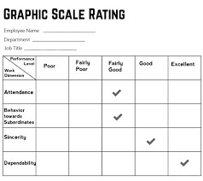
8. Graphic Rating Scale Method:
The graphic rating scale is one of the most popular and simplest technique for appraising performance. It is also known as linear rating scale. In this method, the printed appraisal form is used to appraise each employee.

Slide 11

Essay method is the simplest one among various
9. Essay Method:
appraisal methods available. In this method, the
rater writes a employee’s
narrative
description on an weaknesses, past
for
strengths,
potential and suggestions
performance,
improvement. Its positive point is that it is simple in use. It does not require complex formats and extensive/specific training to complete it.

Slide 12
This is an appraisal done by someone outside employees, own department usually from corporate or HR department.
10. Field Review Method:
Advantages: Useful for managerial level promotions, when comparable information is needed. Disadvantages: Outsider is generally not familiar with employees work environment, Observation of actual behaviors not possible.

Slide 13

It is the traditional way of appraising employees
11. Confidential Report:
mainly in Evaluation
the Government Departments. is made by the immediate boss or for giving effect to promotion and
supervisor
transfer. Usually a structured format is devised to
collect information
on employee’s
attitude,
strength character,
weakness, intelligence, attendance, discipline, etc.

Slide 14
Modern methods are as follows:-
Management by Objectives (MBO)
Behaviourally Anchored Rating Scales (BARS)
Assessment Centers
360 – Degree Appraisal
Human Resource Accounting

Slide 15

The concept of MBO can be described as a
1. Management by Objectives (MBO):
“process whereby the superior and subordinate managers of an organization jointly identify its common goals, define each individual’s major areas of responsibility in terms of results expected of him, and use these measures as guides for operating the unit and assessing the contribution of each its members”.

Slide 16
Behaviourally Anchored Rating Scales (BARS) are
2. Behaviourally Anchored Rating Scales (BARS):
designed to bring the benefits of both qualitative and quantitative data to the employee appraisal process. BARS compare an individual’s performance against specific examples of behaviour that are anchored to numerical ratings.

Slide 17
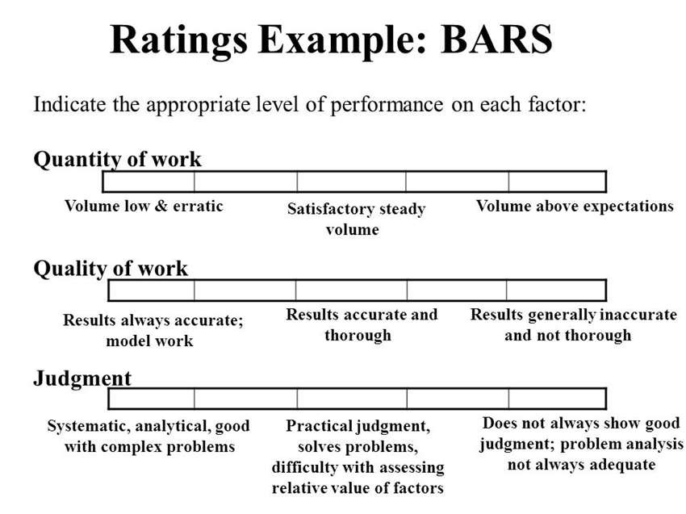

Slide 18

An assessment center is a central location where
3. Assessment Centers:
the managers may come together to participate in
job related exercises evaluated observers. The principle idea is
by trained to evaluate
managers over a period of time, by observing and later evaluating their behaviour.

Slide 19

In 360-degree appraisal system, an employee is
4. 360 – Degree Appraisal:
appraised by his supervisor, subordinates, peers, and customers with whom he interacts in the course of his job performance. All these appraisers provide information or feedback on an employee by completing survey questionnaires designed for this purpose.

Slide 20
Human resource method attaches money values
5. Human Resource Accounting:
to the value of a firms internal human resources and its external customer good will. Under this method, performance is judged in terms of costs and contributions of employees. Difference between the cost and contribution will reflect the performance of the employees.

Slide 21
THE END

